Slide 1
YOLO v1
Author: QChen
Date: Apr 18 2019
汇报人：第PPT

Slide 2
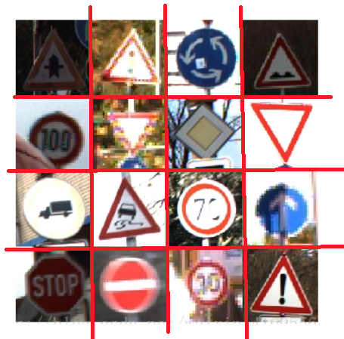
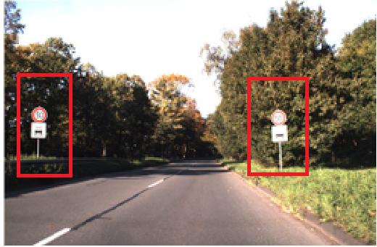
YOLO v1
Object Detection Model
Object Recognition
Object Detection

Slide 3
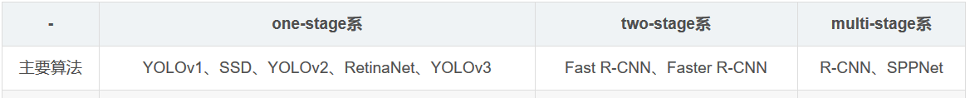
YOLO v1
Foresight Review
end-to-end learning: One CNN
end-to-end training: One loss function, may be independently trained
end-to-end model: Integrate independent modules
multi-stage: Independent module
one-stage

Slide 4
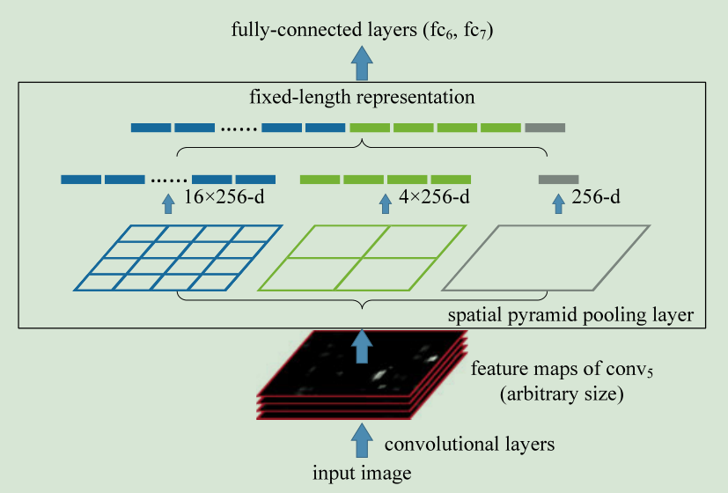
YOLO v1
Foresight Review
SPP Architecture

Slide 5
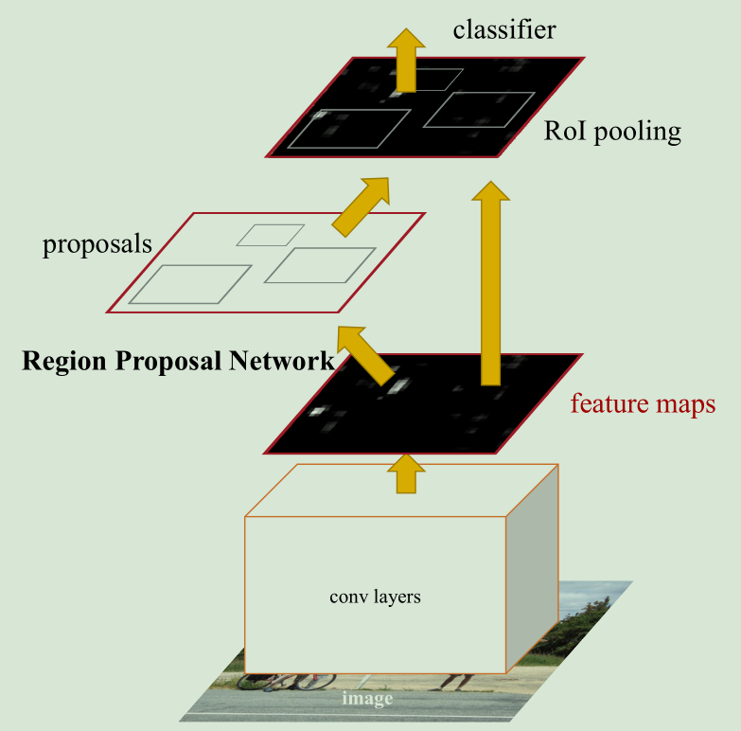
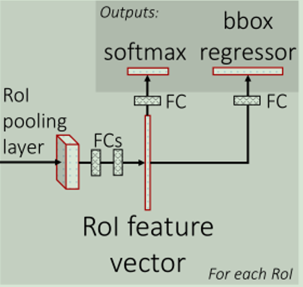
YOLO v1
Foresight Review
Faster RCNN Architecture

Slide 6
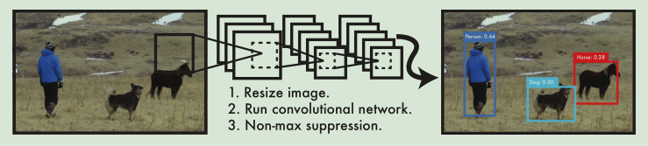
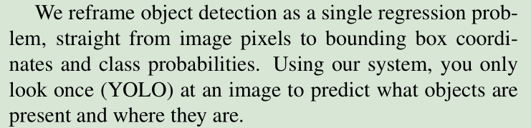
YOLO v1
paper: You Only Look Once: Unified, Real-Time Object Detection

Slide 7
YOLO v1
1. Unified Detection
Our network uses features from the entire image to predict each bounding box

Slide 8
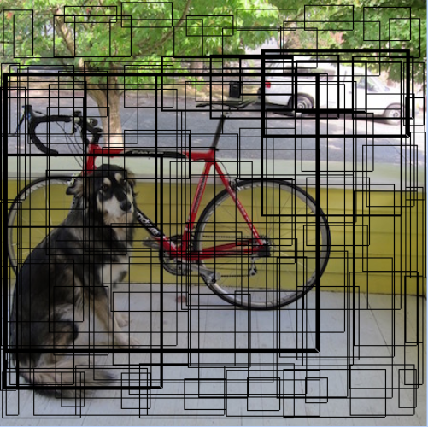
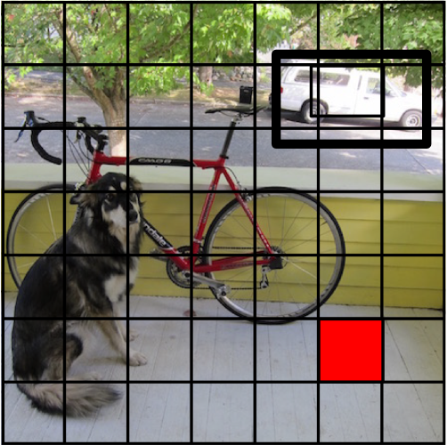
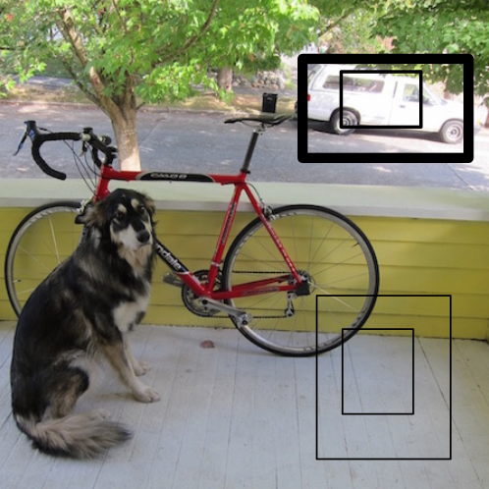
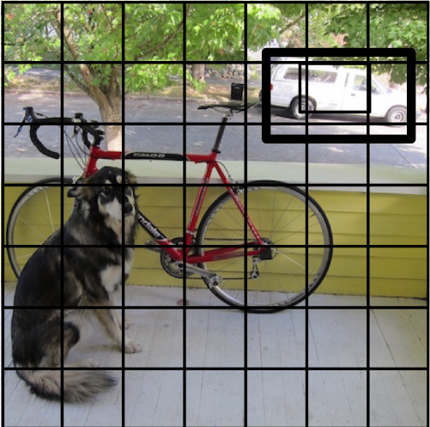
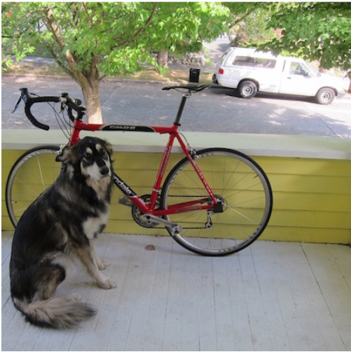
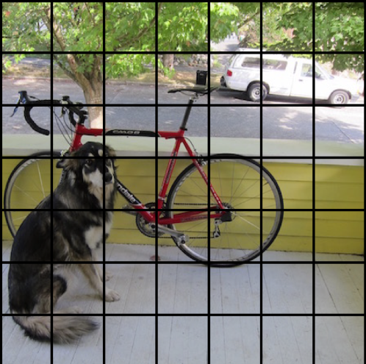
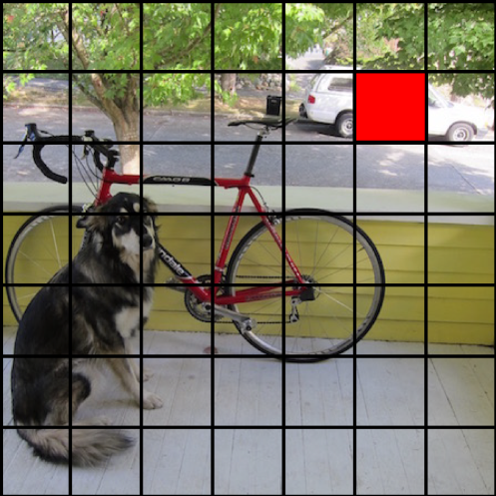
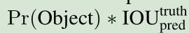
YOLO v1
1. Unified Detection
Each grid cell predicts B bounding boxes and
confidence scores for those boxes

Slide 9
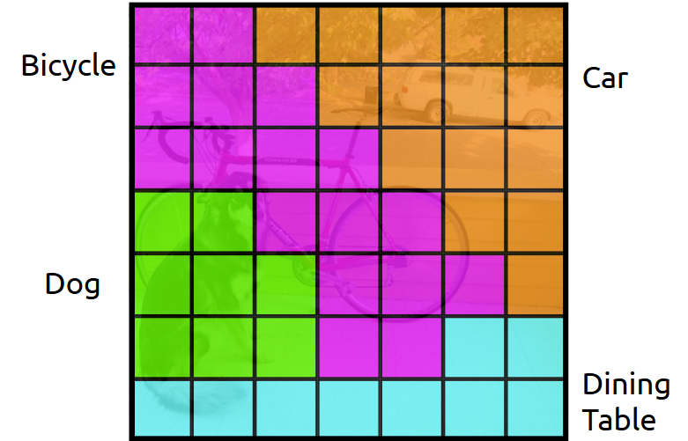
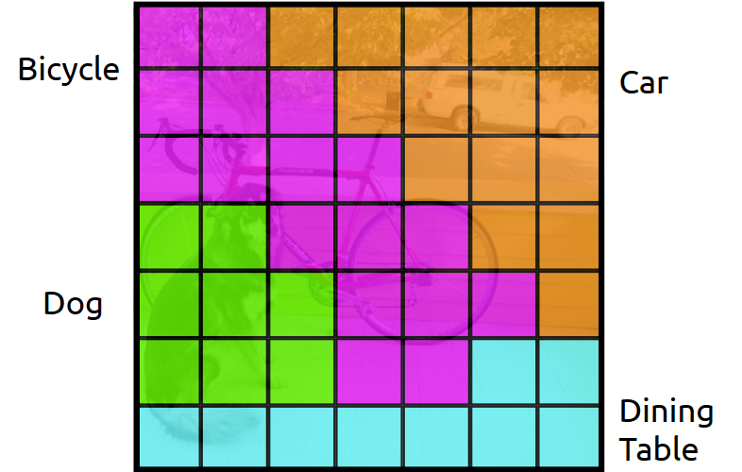
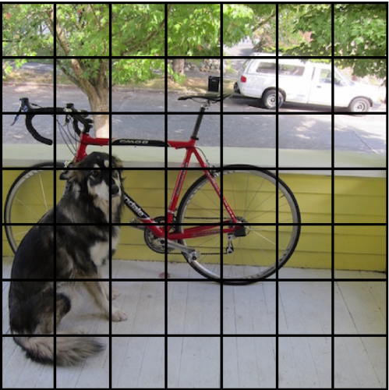
YOLO v1
1. Unified Detection
Each cell also predicts
a class probability.
Conditioned on object: P(Car | Object)

Slide 10
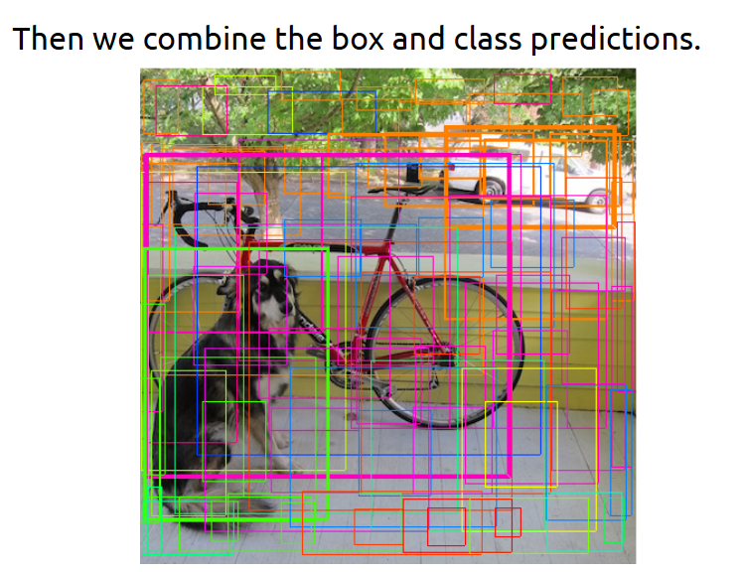
YOLO v1
1. Unified Detection

Slide 11
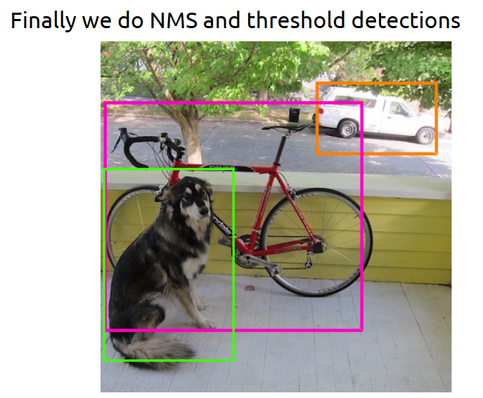
YOLO v1
1. Unified Detection

Slide 12
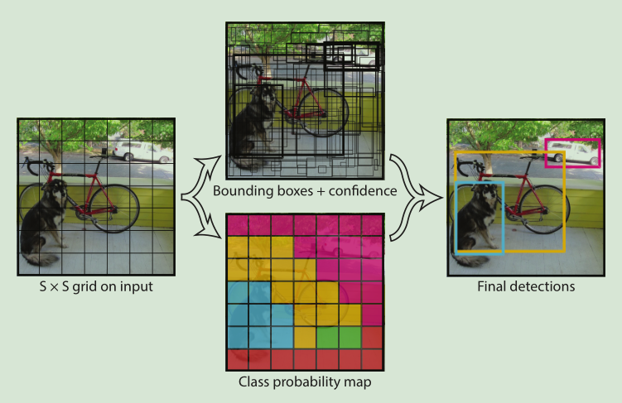
YOLO v1
1. Unified Detection
Our network uses features from the entire image to predict each bounding box

Slide 13
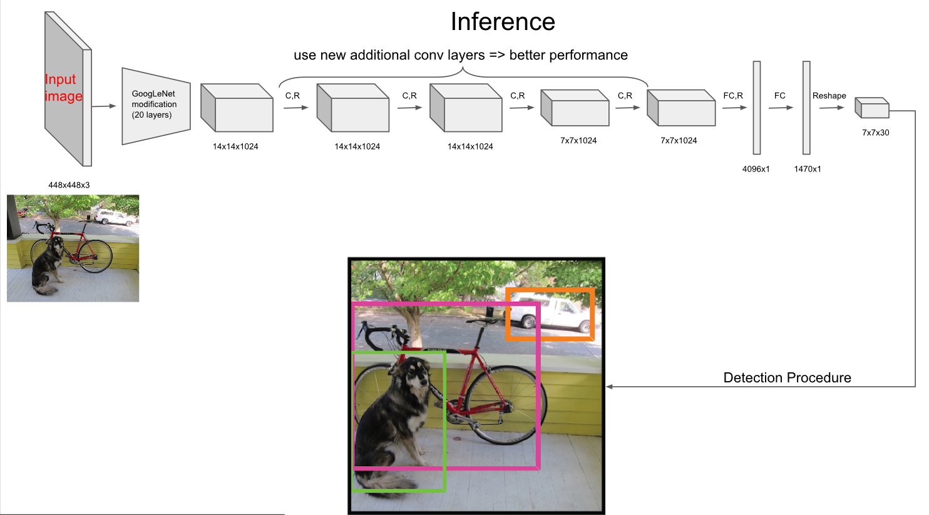
YOLO v1
2. Network Design
Our network architecture is inspired by the GoogLeNet model for image classification.

Slide 14
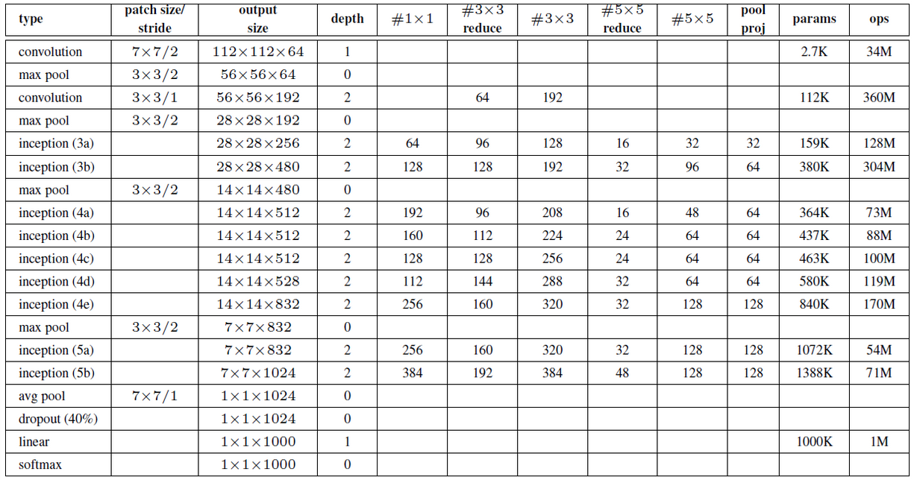
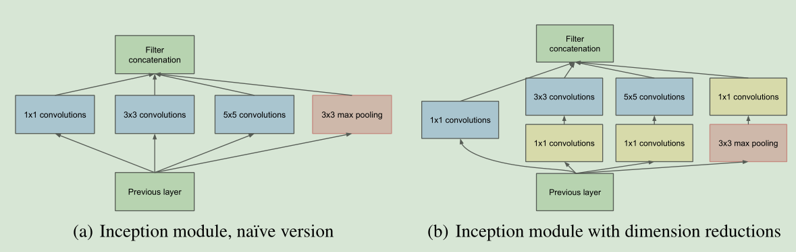
YOLO v1

Slide 15
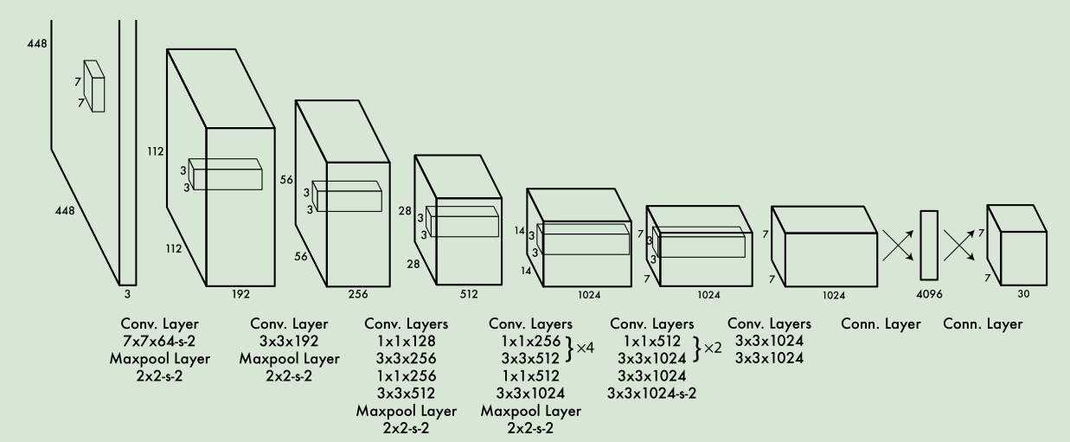
YOLO v1
2. Network Design

Slide 16
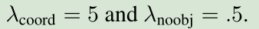
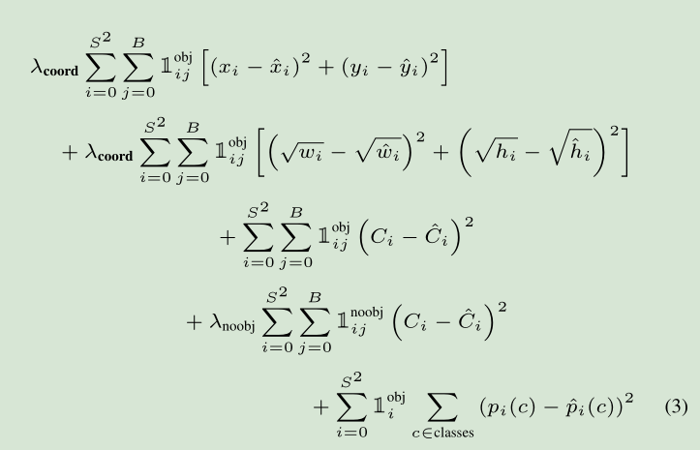
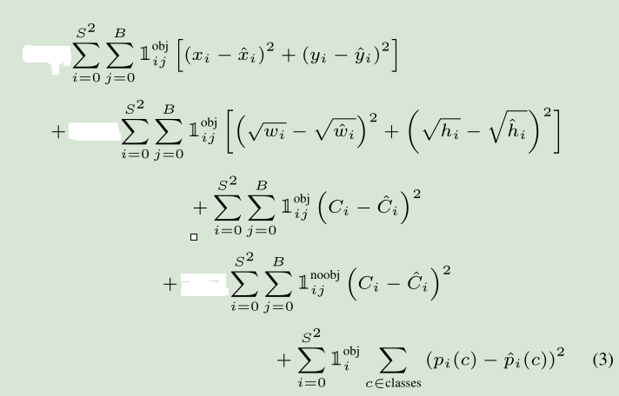
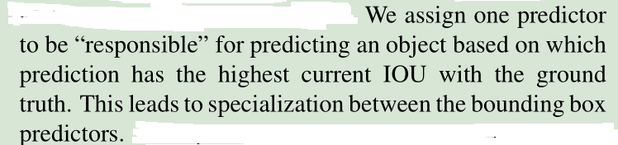
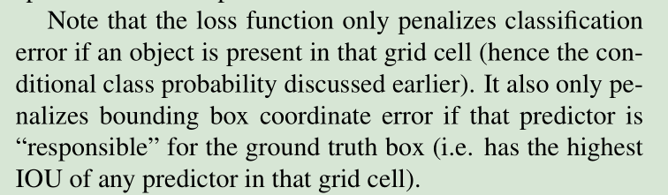
YOLO v1
3. Training

Slide 17
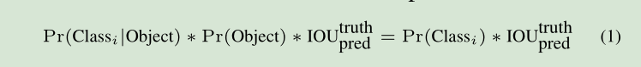
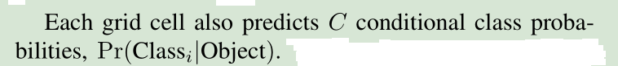
YOLO v1
4. Inference test-time
class-specific confidence scores for each box

Slide 18
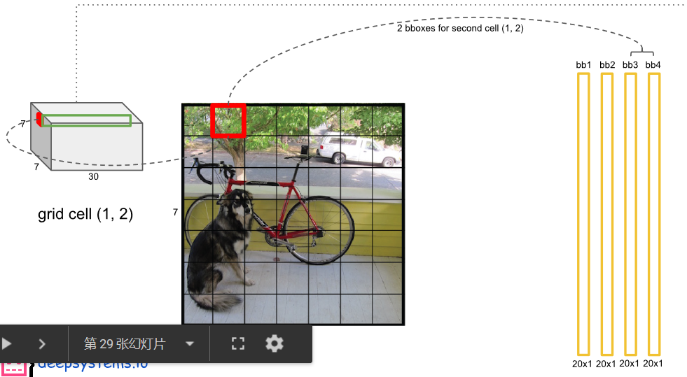
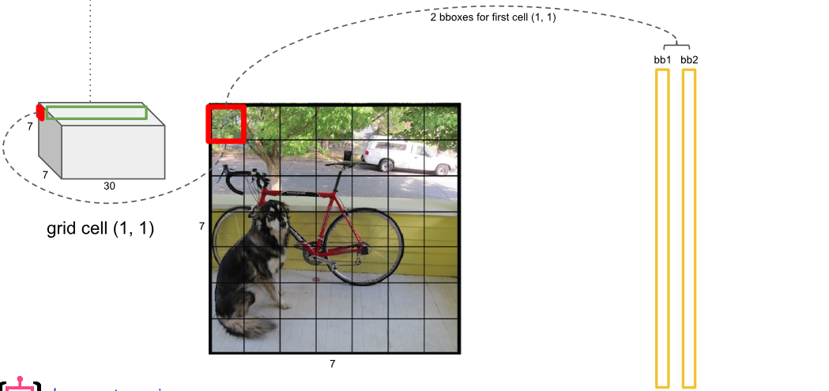
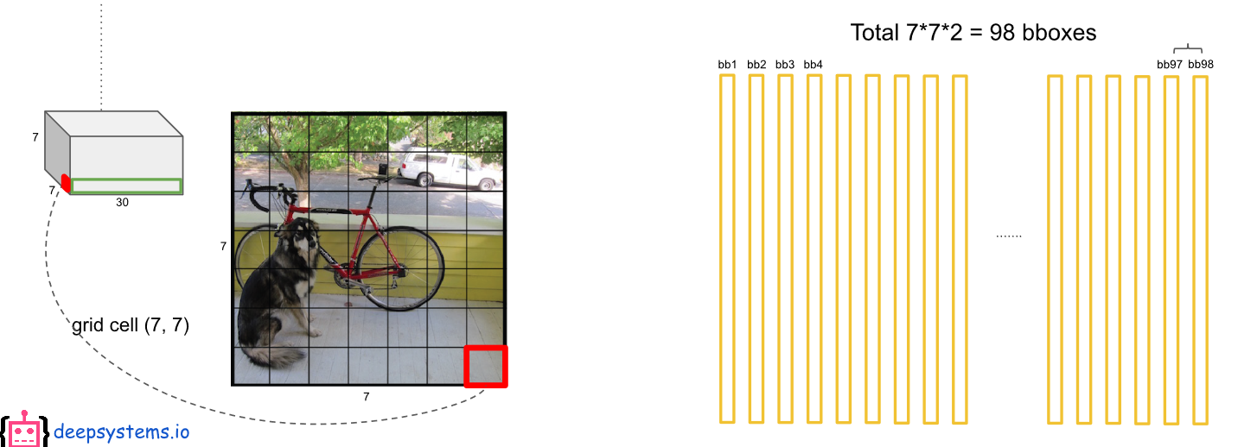
YOLO v1
4. Inference

Slide 19
YOLO v1
4. Inference

Slide 20
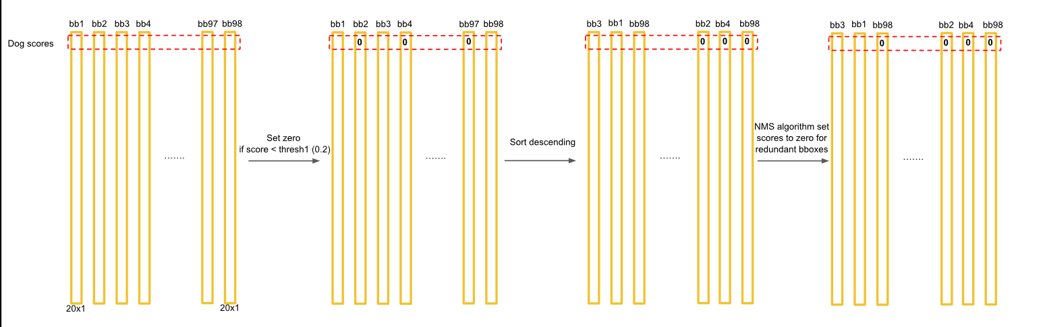
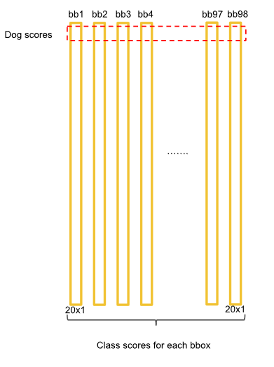
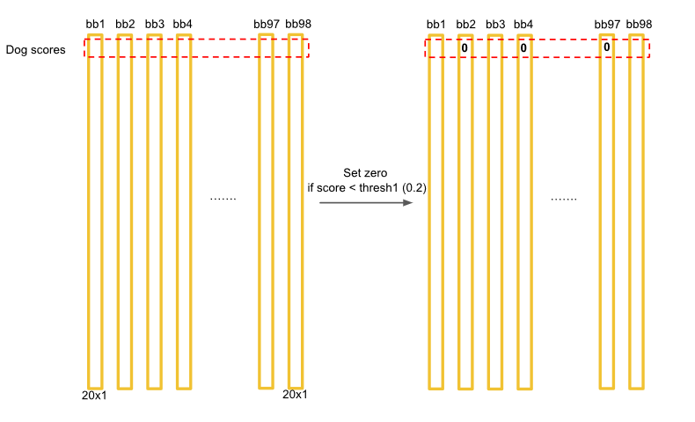
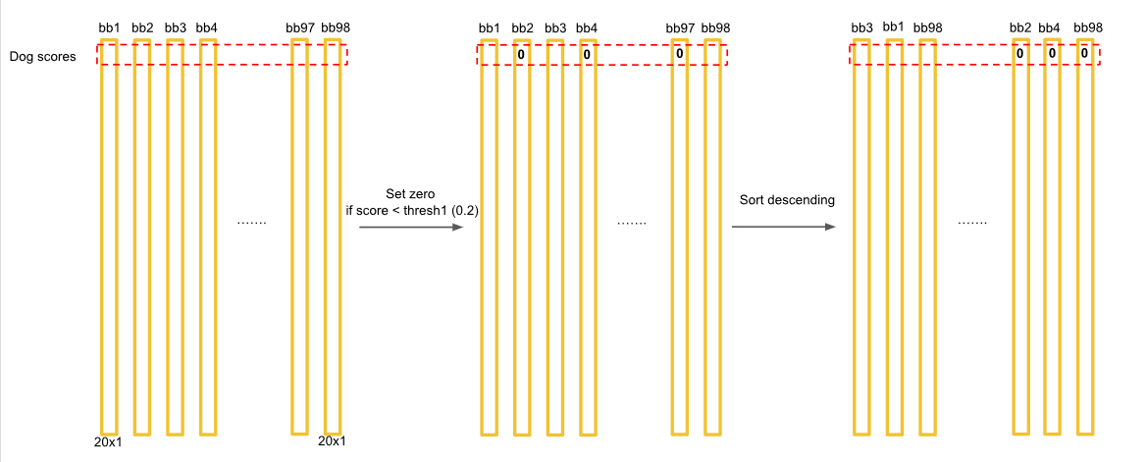
YOLO v1
4. Inference

Slide 21
YOLO v1
4. Inference
Example
https://docs.google.com/presentation/d/1aeRvtKG21KHdD5lg6Hgyhx5rPq_ZOsGjG5rJ1HP7BbA/pub?start=false&loop=false&delayms=3000#slide=id.g137784ab86_4_4448
https://www.bilibili.com/video/av37448440/?redirectFrom=h5

Slide 22
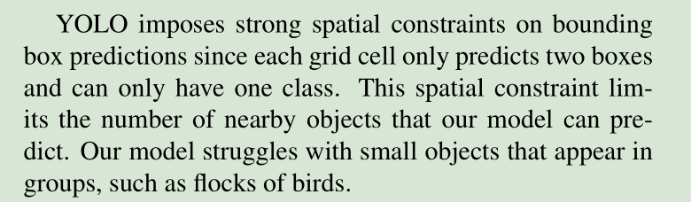
YOLO v1
5. Limitations
Our main source of error is incorrect localizations.

Slide 23
Fast R-CNN
Advantages
1. YOLO is extremely fast
2. YOLO reasons globally about the image when making predictions
False Positive: less than half the number of background errors
3. YOLO learns generalizable representations of objects
Disadvantages
Accuracy
Our main source of error is incorrect localizations
it struggles to precisely localize some objects, especially small ones

